Slide 1
Testing Web Based System

Slide 2
Testing Web Based System
Web testing is a software testing technique to test web applications or websites for finding errors and bugs.
A web application must be tested properly before it goes to the end-users.
Also, testing a web application does not only mean finding common bugs or errors but also testing the quality-related risks associated with the application.
Software Testing should be done with proper tools and resources and should be done effectively.
Testing a web application includes the analysis of the web fault compared to the general software faults.
Web applications are required to be tested on different browsers and platforms so that we can identify the areas that need special focus while testing a web application.

Slide 3
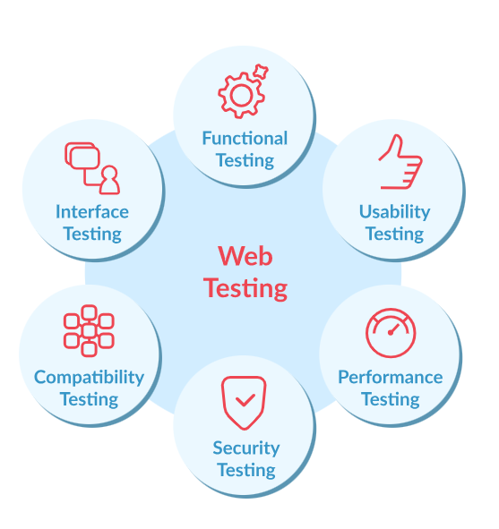

Slide 4
Types of Software Web Application Testing
Static Website Testing:
A static website is a type of website in which the content shown or displayed is exactly the same as it is stored in the server.
This type of website has great UI but does not have any dynamic feature that a user or visitor can use.
In static testing, we generally focus on testing things like UI as it is the most important part of a static website.
We check things font size, color, spacing, etc. testing also includes checking the contact us form, verifying URLs or links that are used in the website, etc.
Dynamic Website Testing:
A dynamic website is a type of website that consists of both a frontend i.e., UI, and the backend of the website like a database, etc.
This type of website gets updated or change regularly as per the user’s requirements.
In this website, there are a lot of functionalities involved like what a button will do if it is pressed, are error messages are shown properly at their defined time, etc.
We check if the backend is working properly or not, like does enter the data or information in the GUI or frontend gets updated in the databases or not.

Slide 5
E-Commerce Website Testing:
An e-commerce website is very difficult in maintaining as it consists of different pages and functionalities, etc.
In this testing, the tester or developer has to check various things like checking if the shopping cart is working as per the requirements or not, are user registration or login functionality is also working properly or not, etc.
The most important thing in this testing is that does a user can successfully do payment or not and if the website is secured.
Mobile-Based Web Testing:
In this testing, the developer or tester basically checks the website compatibility on different devices and generally on mobile devices because many of the users open the website on their mobile devices.
So, keeping that thing in mind, we must check that the site is responsive on all devices or platforms.

Slide 6
Objectives of Web Based Testing:
Testing for functionality: Make that the web application performs as expected for all features and functions. Check that user interface elements like form submissions and navigation work as intended.
Testing for Compatibility: To make sure it is compatible, test the web application across a variety of devices, operating systems, and browsers. Verify that the program operates consistently in a range of settings.
Evaluation of Performance: Analyze the online application’s overall performance, speed, and responsiveness. Any performance bottlenecks, such as slow page loads or delayed server response times, should be located and fixed.
Testing for load: Examine how well the web application can manage a particular load or multiple user connections at once. Determine and fix performance problems when there is a lot of traffic.
Testing for accessibility: Make sure the online application complies with applicable accessibility standards (e.g., Web Content accessibility guidelines (WCAG)) and is usable by people with disabilities. Make sure the program can communicate with assistive technologies efficiently.
Testing Across Browsers: Make sure the operation and appearance of the web application are consistent by testing it in various web browsers. Determine and fix any problems that might develop with a particular browser.

Slide 7
How to Execute Web Based Testing?
The software web application testing can be executed by the ways listed below −
Step 1 − The software web application testing should comprise the verification of the frontend, backend, firewalls, internet protocols and all other entities that are required to run the website on the server.
Step 2 − Verify if all the screens possess the correct URL or links.
Step 3 − Verify if the web application under test is compatible with other systems.
Step 4 − Verify if all the dimensions of the images and displays are appropriate for all kinds of end users.
Step 5 − Verify the security features of the website.
Step 6 − Verify all the details on the analytics of the websites.
Step 7 − Verify if all the customer contact information is correctly updated on the website.

Slide 8
Mobile Application Testing
Mobile Application Testing refers to the process of evaluating the functionality, usability, and performance of mobile apps across various devices and platforms.
To ensure they meet quality standards and deliver a seamless user experience.
It encompasses testing aspects such as functionality, compatibility, security, and user interface to identify and rectify issues before the app's release.
Types of Mobile Applications:
Native Apps: Developed for a specific platform (e.g., iOS, Android) using platform-specific programming languages and APIs.
Web Apps: Accessed through mobile web browsers and often built using web technologies like HTML5, CSS, and JavaScript.
Hybrid Apps: Combine elements of both native and web apps, typically using web technologies but wrapped in a native shell for distribution.

Slide 9
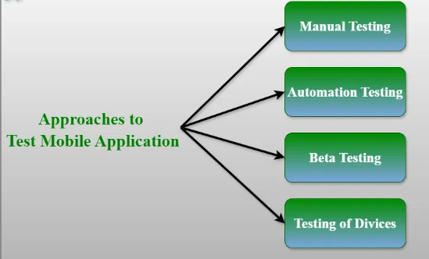
Approaches to Test the Mobile Applications

Slide 10
1. Manual Testing
Exploratory testing: It involves testers experimenting with the program to find bugs without using pre-defined test cases.
Ad Hoc Testing: To find issues rapidly, testers do spontaneous tests without a hard and fast methodology.
Usability testing: To ensure the software program lives as much as consumer expectancies, testers determine the user interface, navigation, and standard consumer experience.
2. Automation Testing
Functional Testing: To test the application's functionality across a range of scenarios and user interactions, automation scripts are written.
Regression Testing: To ensure that new updates do not add any new issues or destroy contemporary capability, automatic tests are performed again after each code exchange.
Testing for Compatibility: Automation scripts are used to check if an application is compatible with various hardware, operating systems, and screen sizes.

Slide 11
3. Beta Testing
Before the app's official release, a small set of actual users are given access to a limited version of it through beta testing.
Beta tester's feedback is useful in locating flaws, usability problems, and potential improvement areas.
4. Testing of Devices
Real Device Testing: To guarantee realistic performance and behavior, the app is tested on real devices, taking into account elements like hardware capabilities and device-specific features.
Emulator/Simulator Testing: The application is evaluated using simulated devices that replicate real-world functionality. For testing Android apps, emulators are utilized, whilst simulators are utilized for testing iOS apps.

Slide 12
Types of Mobile Application Testing
Installation Testing: To guarantee a seamless and error-free installation experience for users, installation testing examines the app's installation procedure, compatibility with various platforms and devices, handling of permissions, and uninstallation.
Accessibility Testing: This process assesses if an application complies with accessibility guidelines (such as WCAG) and whether it is user-friendly enough for people with disabilities, such as those who have cognitive, motor, visual, or hearing impairments.
Automation Testing: To increase productivity, accuracy, and test coverage, automated testing uses tools and scripts to automate repetitive testing tasks like performance, functional, and regression testing.
Security Testing: Testing for vulnerabilities and dangers in data security, authentication, authorization, encryption, and defense against malware, hacking, and other cyber threats is known as security testing.
Functional testing: This kind of testing confirms that the application operates as intended and meets all requirements. Input validation, navigation, user interface, and other functional aspects are all tested.
User Acceptance Testing (UAT): Before the app's official release, actual users test it in a setting similar to production to see if it satisfies their wants, expectations, and business requirements.

Slide 13
Mobile Application Testing Strategies
Establish Clear Needs and Objectives: Clearly state the needs, acceptance criteria, and functional, performance, usability, security, and compatibility requirements for the application.
Testing Early in the Development Lifecycle: By testing early in the process, problems can be found and fixed more quickly, saving money and effort in later stages of the project.
Test Automation: To increase productivity, accuracy, and test coverage, automate repetitive and time-consuming tests including performance, functional, and regression testing.
Real-World Testing Scenarios: Simulate real-world user interactions, network circumstances, device setups, and environmental constraints, such as low battery life, spotty connectivity, or interruptions, while testing the app in real-world settings.
Feedback Mechanisms and Bug Reporting: Implement feedback mechanisms and bug reporting capabilities in the app so that users may report problems, offer comments, and recommend changes.
Documentation and Reporting: Test cases, outcomes, and problems observed during testing should all be recorded. Detailed reports should be produced to monitor development, disseminate information, and aid in decision-making.

Slide 14
Types of Mobile Emulator
Native Emulators:
These emulators, like iOS Simulator for iOS and Android Virtual Device (AVD) for Android, are offered by the operating system vendors.
By providing precise emulations of the corresponding platforms, they enable developers to test apps in a setting that closely mimics actual hardware.
Browser-Based Emulators:
These emulators, which include Sauce Labs and BrowserStack, allow mobile web applications to be tested on a variety of devices and browsers without requiring local installations.
They work by simulating mobile devices within web browsers.
Hardware Emulators:
Hardware emulators use hardware virtualization technology to speed up virtualized Android device performance, increasing testing efficiency and speed.
One example of such an emulator is Intel Hardware Accelerated Execution Manager (HAXM).
Appium Emulators:
Appium is an open-source test automation framework that offers a uniform interface for testing on iOS, Android, and Windows devices.
It allows testing mobile apps utilizing emulators and simulators across several platforms.
Cloud-Based Emulators:
These emulators, which include AWS Device Farm and Firebase Test Lab, give developers remote access to a large number of genuine devices that are housed in the cloud.
This enables them to do testing on a variety of platforms and device configurations.

